Slide 1

MACHINE LEARNING
LOVELY PROFESSIONALS UNIVERSITY
Name – Mohit Singh sec – K20KT Roll no – 12
Reg - 12013468

Slide 2
Introduction
DATA SET :- Adult Census Income
ROWS AND COLOUMN :- (32561 , 15)
EXPLORATORY DATA ANALYSIS
Machine learning Algorithm used:-
Logistic Regression
RandomForest Regression
Naïve Bayes

Slide 3
Problem Statement
We have to predict the income of a person whether he/she is earning more than 50k or less then 50k on the basis of certain factors like age, work class, education, marital status, occupation, relationship, race, sex, hours per week, native country etc. using different machine learning algorithm.

Slide 4
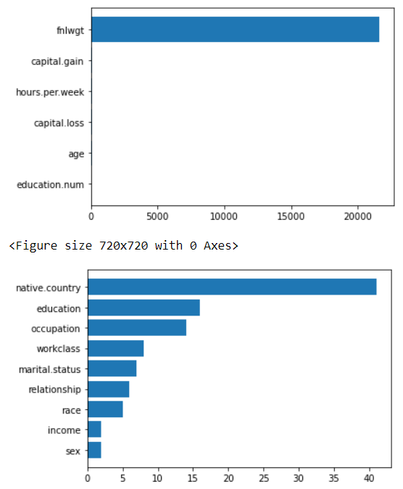
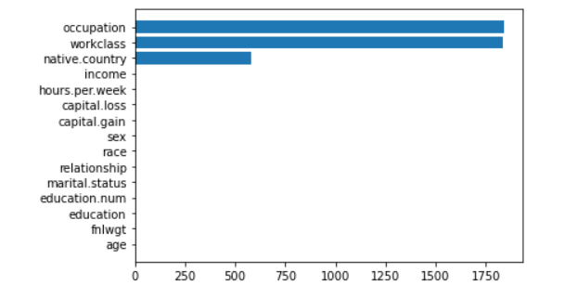
EXPLORATORY DATA ANALYIS
. It can be inferred from the plot that only occupation workplace and native country have null values
Bar plot which shows the distribution of unique value of data set

Slide 5
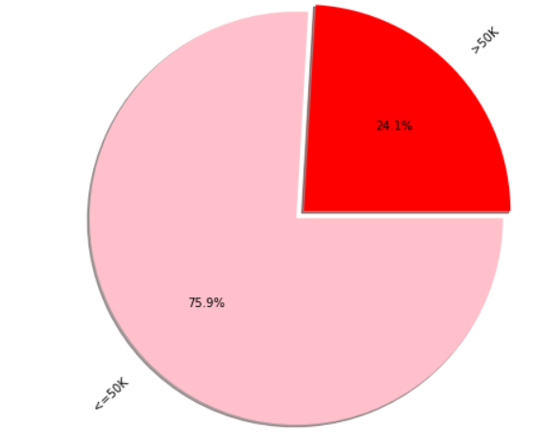
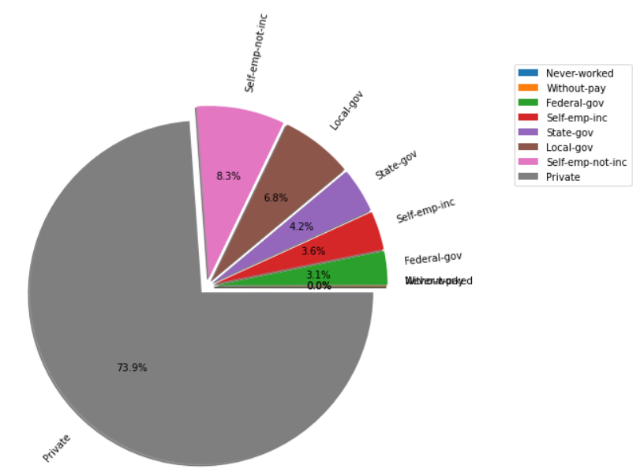
INCOME
WORKPLACE
Pie chart which shows the distribution of income. It can be inferred from the chart that more than 75% income is less than 50k
Pie chart which showsthe distribution of work class . It can be inferred from the chart that more than 73% income is private class

Slide 6
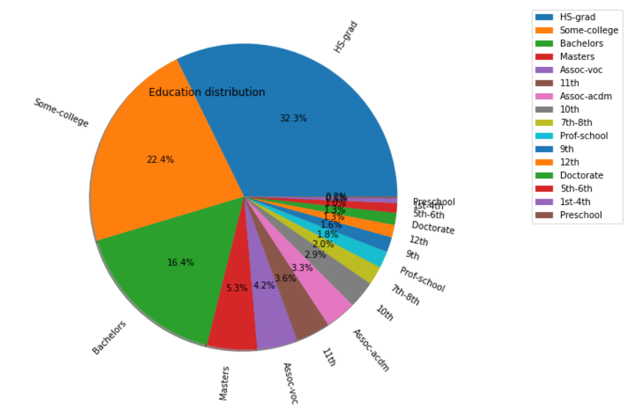
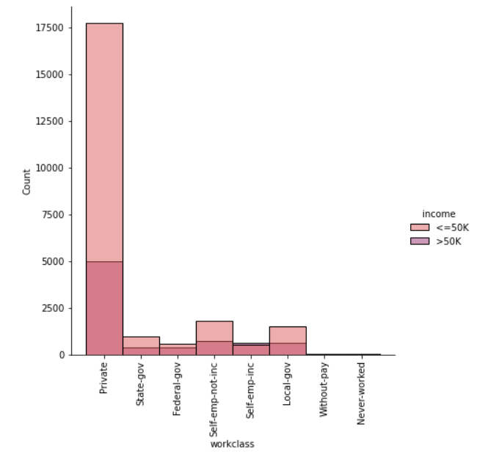
EDUCATION
WORKPLACE VS INCOME
Pie chart which shows the distribution of Education . It can be inferred from the chart that more than 32% are educated in High Secondary Graduation
Histogram chart which shows the distribution of work class with respect to income. It can be inferred from the chart that private class has more number of income source and more number of person who has earning more than 50k and less than 50k

Slide 7
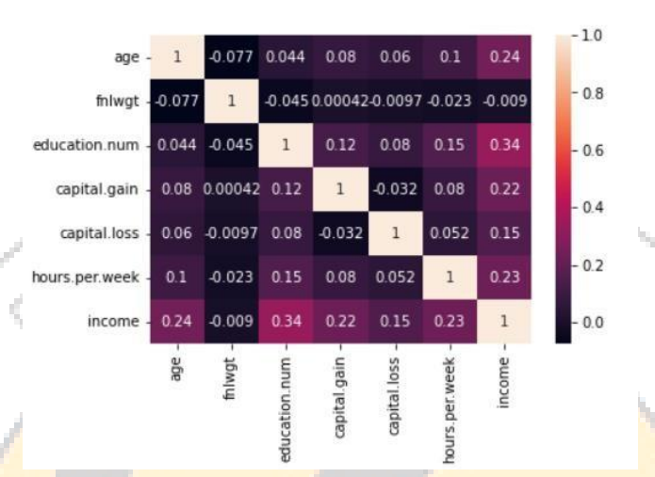
CHECKING MULTICOLINIERTY

Slide 8
Machine Learning Algorithm used
Logistic Regression:-
Logistic regression is a supervised machine learning algorithm mainly used for classification tasks where the goal is to predict the probability that an instance of belonging to a given class. It is used for classification algorithms its name is logistic regression. it’s referred to as regression because it takes the output of the linear regression function as input and uses a sigmoid function to estimate the probability for the given class. The difference between linear regression and logistic regression is that linear regression output is the continuous value that can be anything while logistic regression predicts the probability that an instance belongs to a given class or not.
ACCURACY :- 79.9%
RandomForest Regression :-
Random Forest is an ensemble technique capable of performing both regression and classification tasks with the use of multiple decision trees and a technique called Bootstrap and Aggregation, commonly known as bagging. The basic idea behind this is to combine multiple decision trees in determining the final output rather than relying on individual decision trees.
ACCURACY :- 84.4%
Bernoulli Naive Bayes:-
Naive Bayes classifiers are a collection of classification algorithms based on Bayes’ Theorem. It is not a single algorithm but a family of algorithms where all of them share a common principle, i.e. every pair of features being classified is independent of each other
ACCURACY :- 72.3%

Slide 9
Conclusion
The main aim was to successfully predict the income of the person from dataset using various classification algorithms and compare their performances. The Exploratory Data Analysis is done on the data set to get insight about the data and get the correlations of the features present. The importance of the features is also plotted. The preprocessing and feature engineering is done and three Classification Algorithms are trained. The performances of the models are compared on the basis of classification report . The Random forest comes to be the best performing algorithm above all other models with an accuracy of 84.44% and over all generalizing well.

